Slide 1
Introductory Java and FTC Programming Workshop
Tools - GitHub
Hanson Chan
Notes:
Hello Everyone! Welcome to my workshop for Introductory Java and FTC Programming. Before I begin, I would like to thank you all for coming, and Esquimalt High School for hosting.

Slide 2
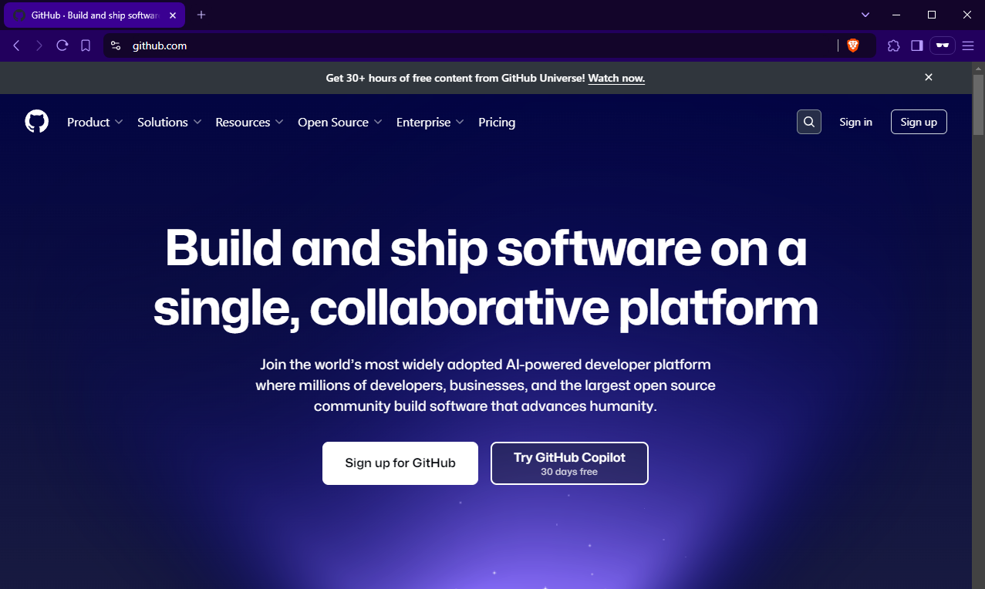
GitHub Website
Sign up

Slide 3
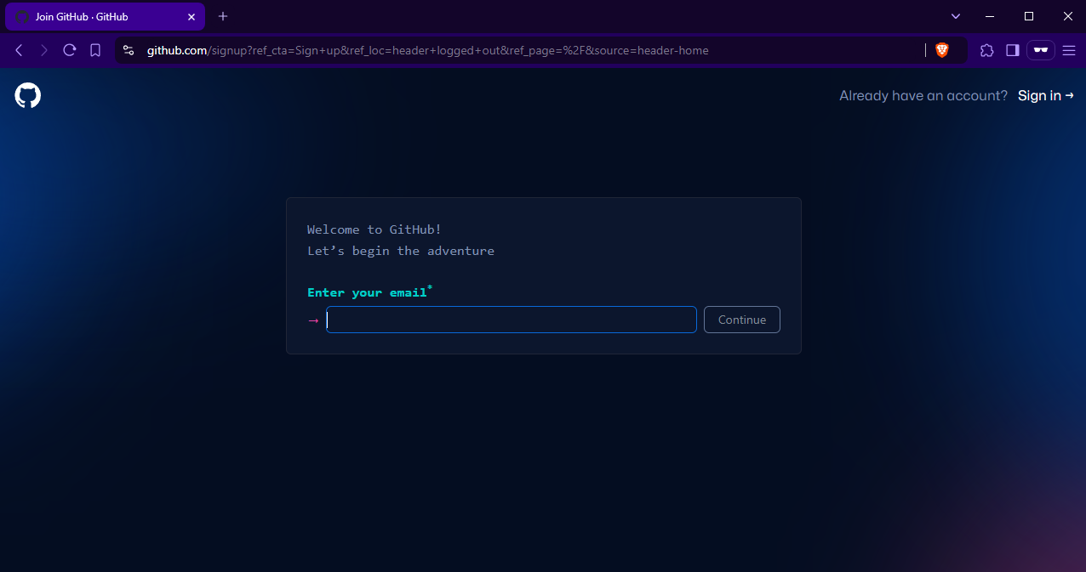
Sign up (Email)

Slide 4
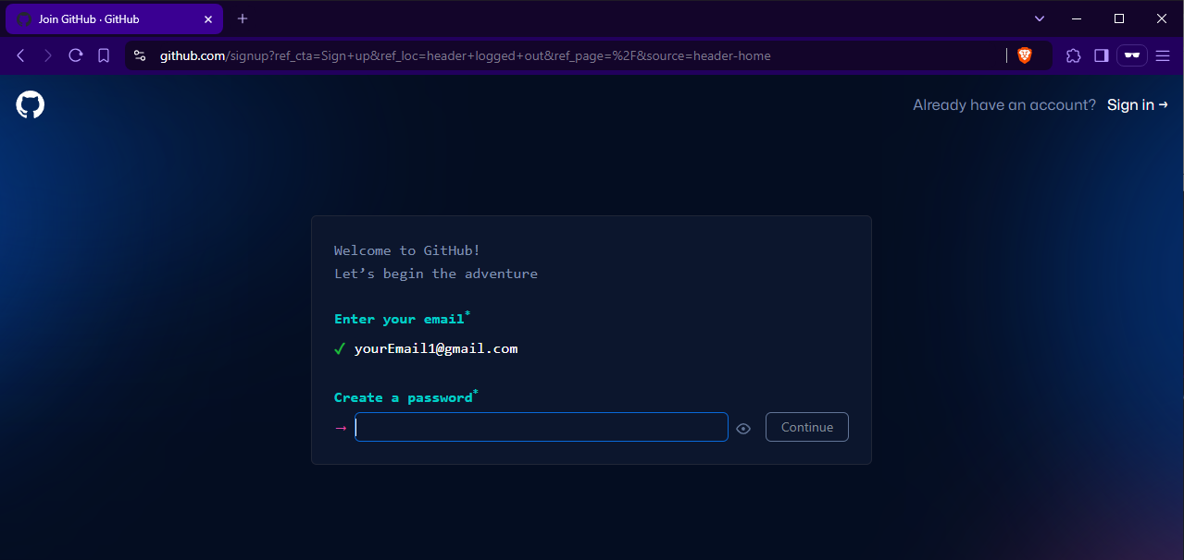
Sign up (Password)

Slide 5
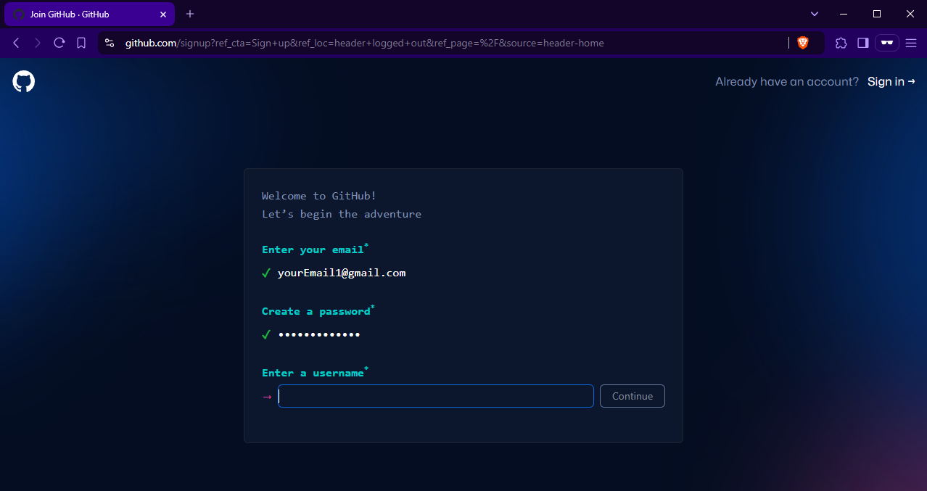
Sign up (Username)

Slide 6
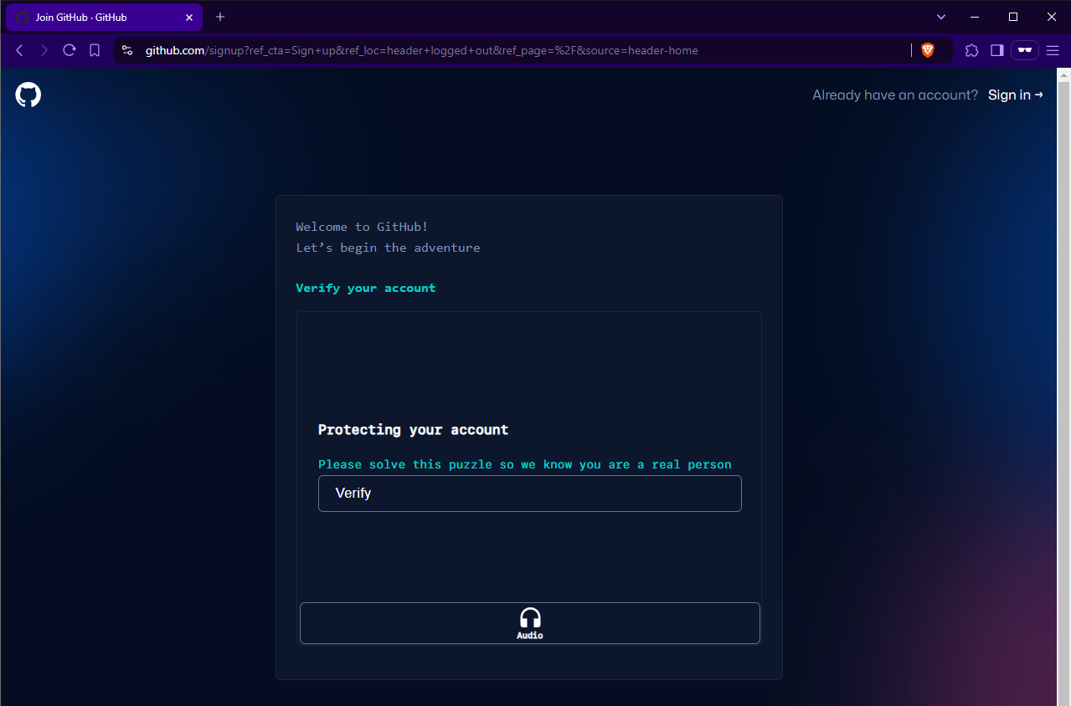
Sign up (Verify)

Slide 7
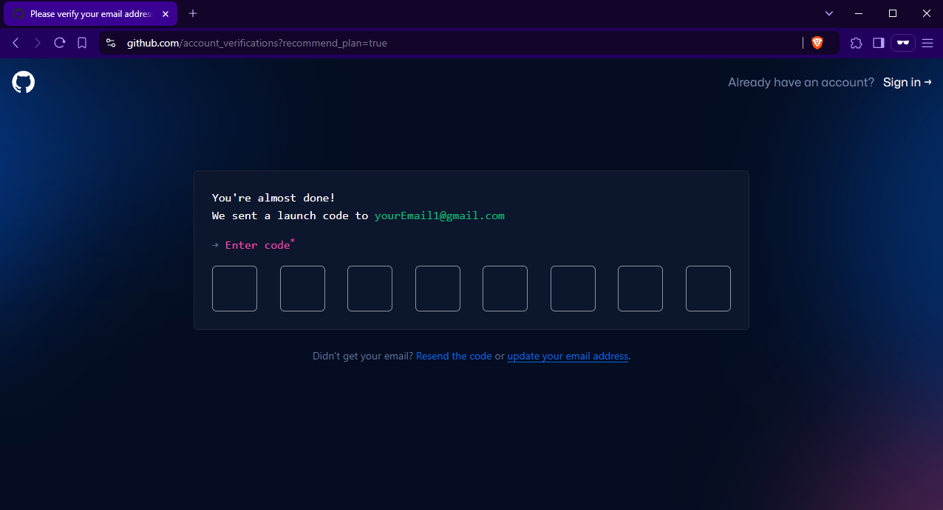
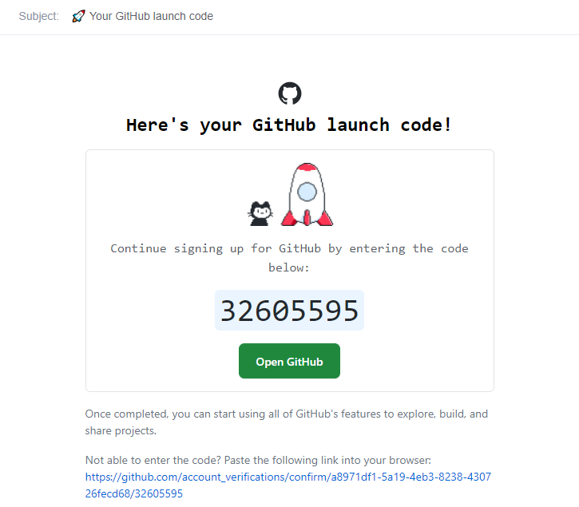
Sign up (2FA Code)

Slide 8
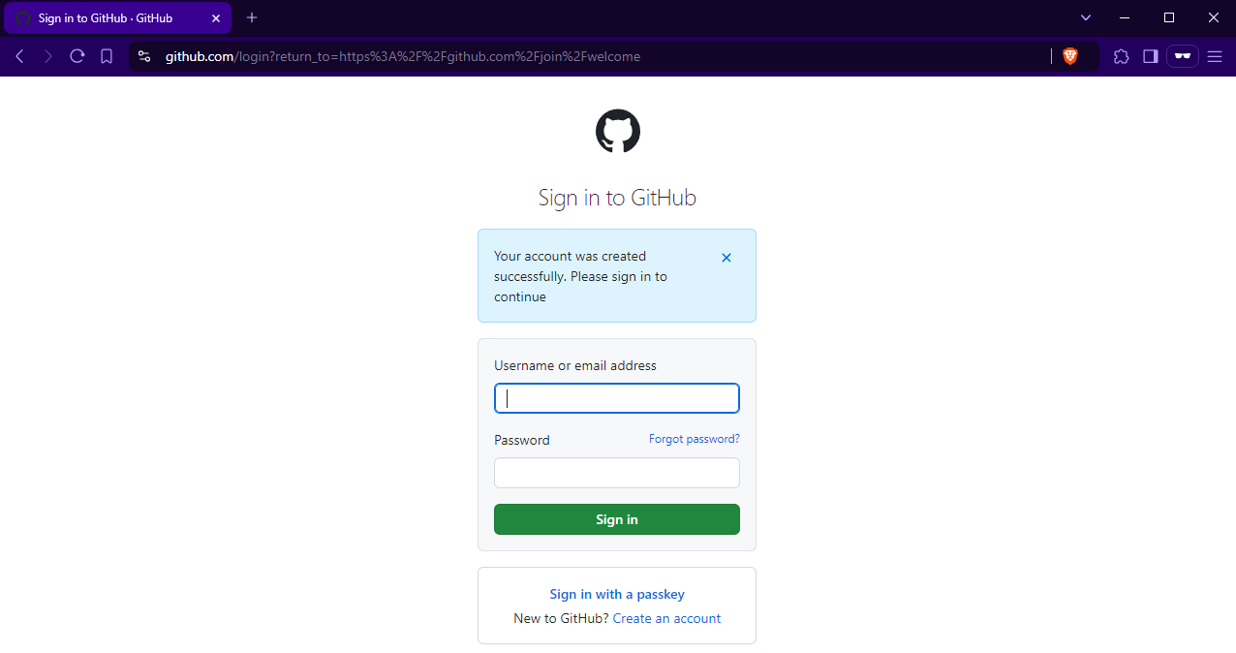
Sign in

Slide 9
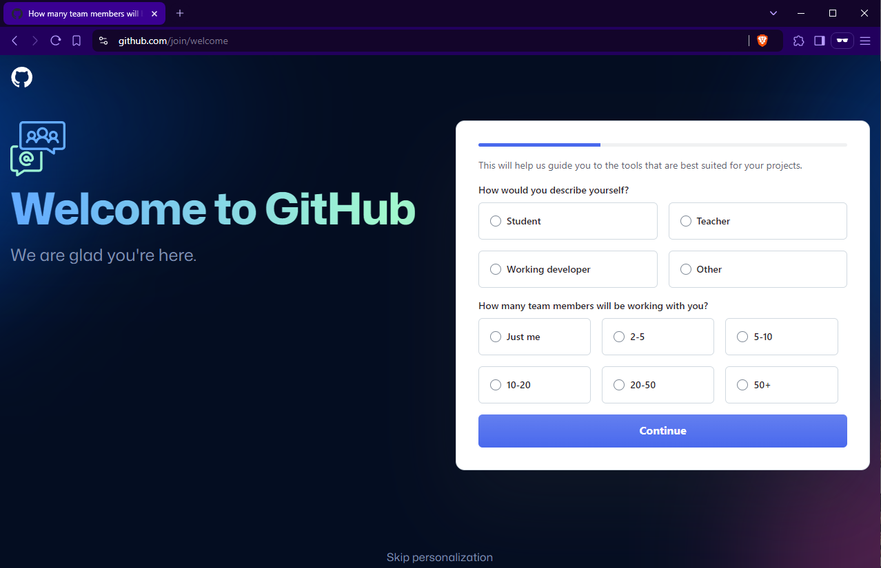
Personalization (Optional)

Slide 10
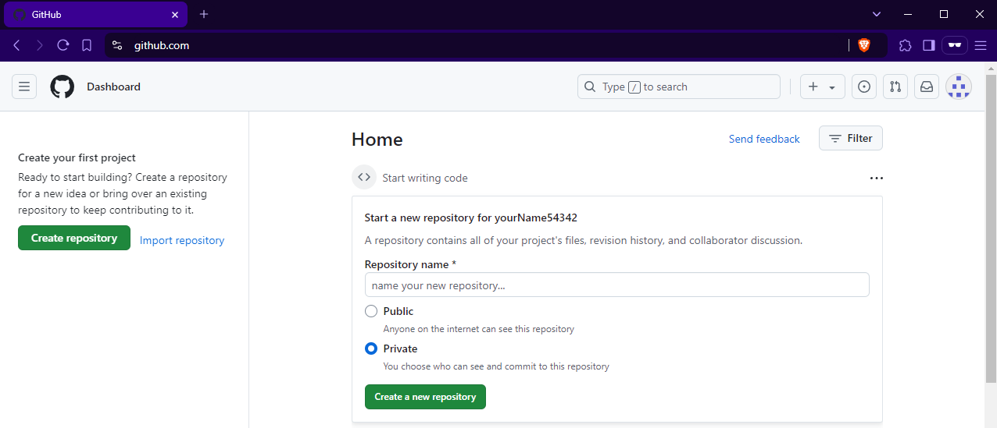
GitHub Dashboard

Slide 11
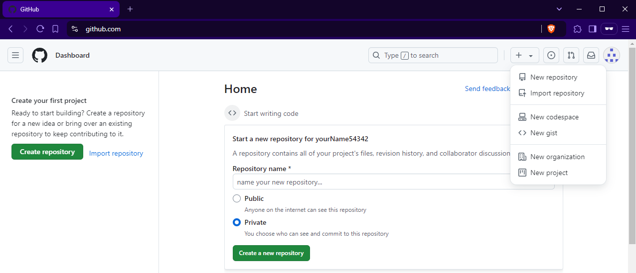
Create Repository (Step 1)
1. Click this arrow
2. New repository

Slide 12
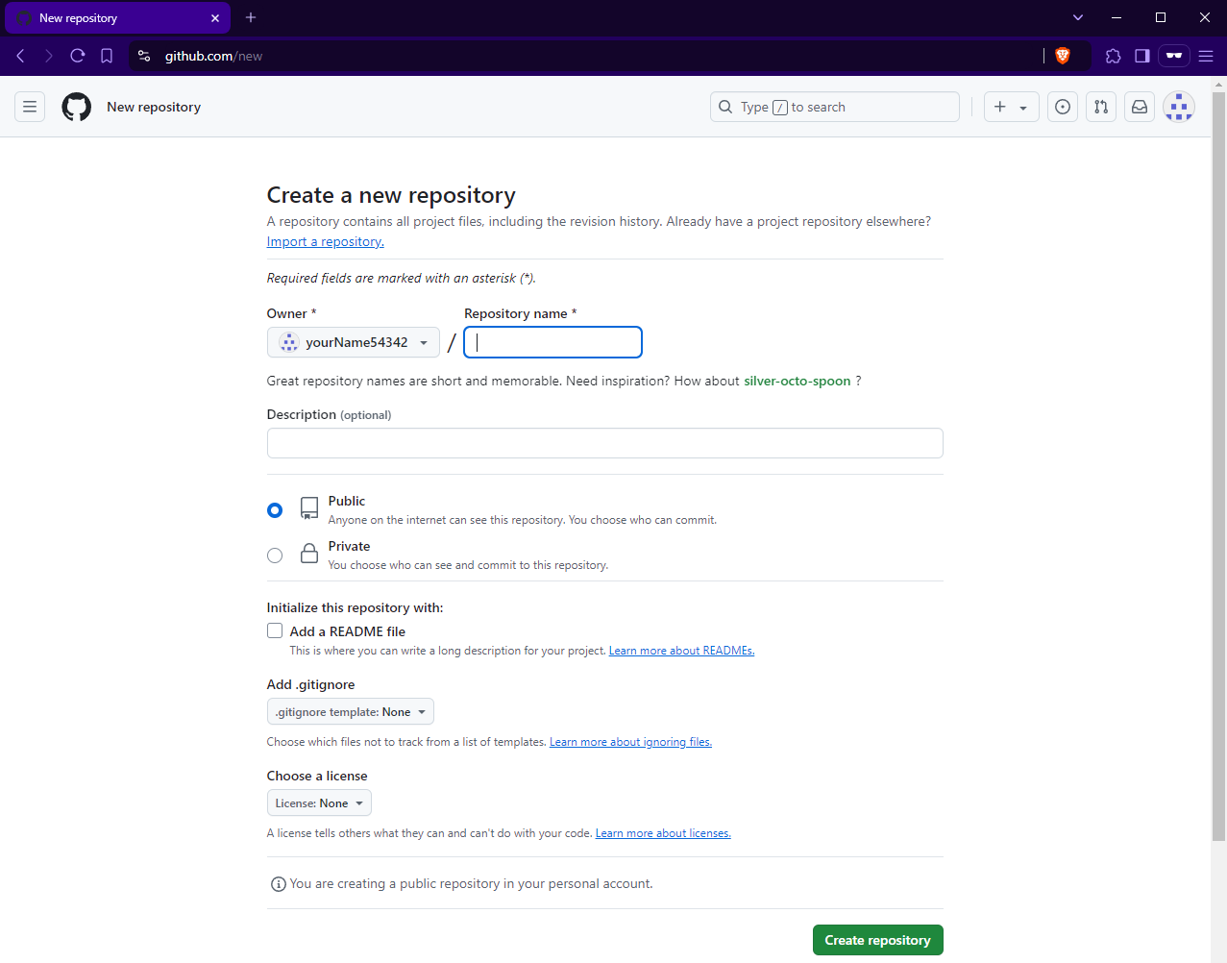
Create Repository (Step 2)
Create repository

Slide 13
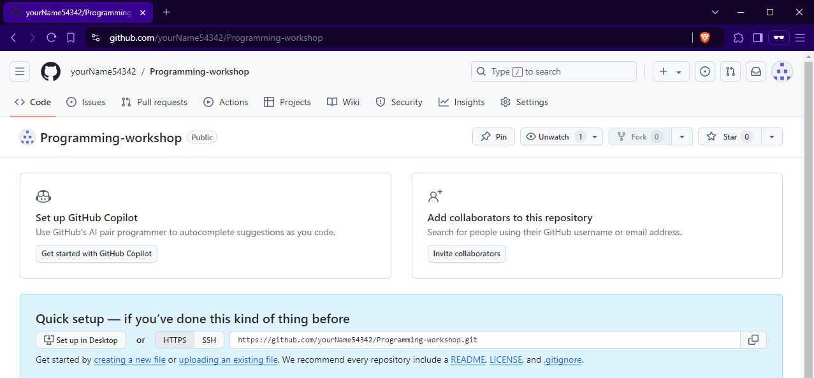
Your Repository

Slide 14
Setup Repository
GitHub Desktop

Slide 15
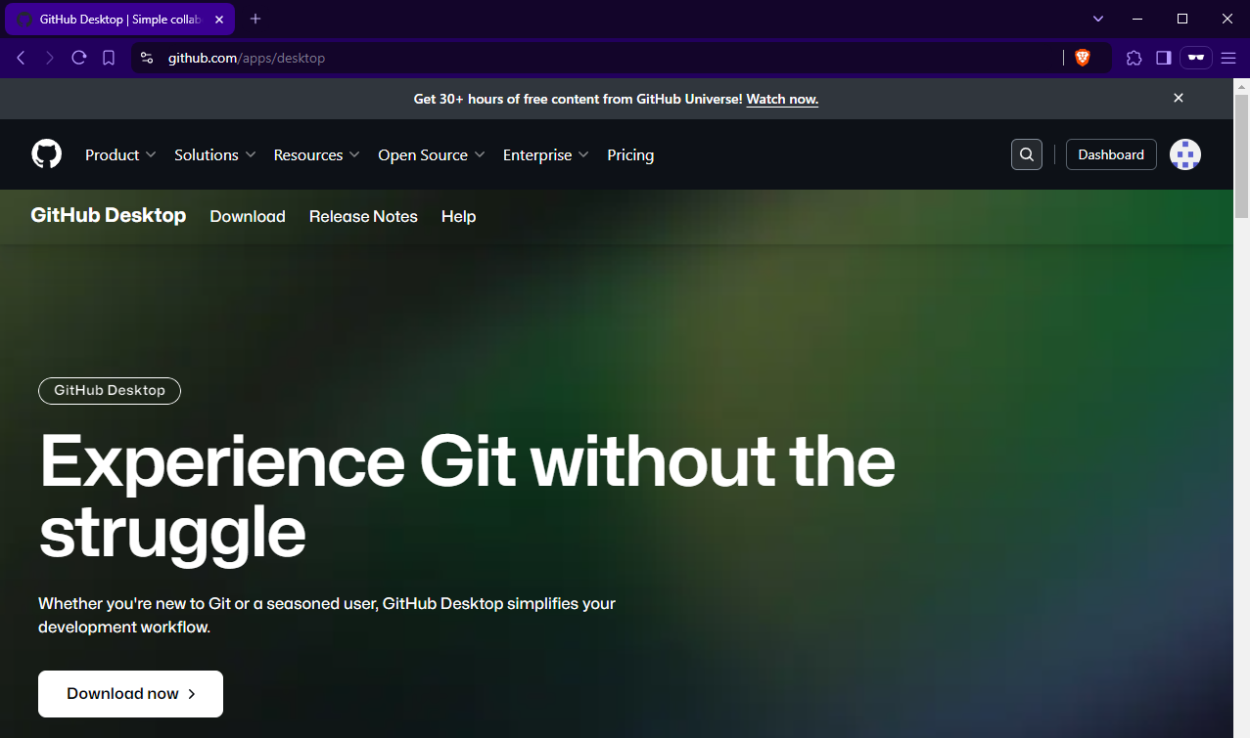
GitHub Desktop Download
Download now

Slide 16
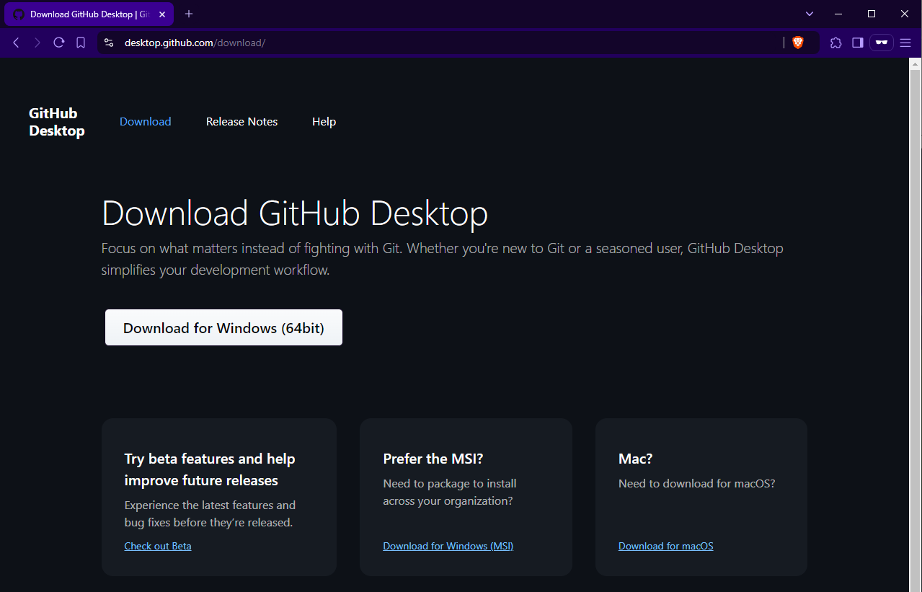
Download (Windows/ macOS)
For Windows
For macOS

Slide 17
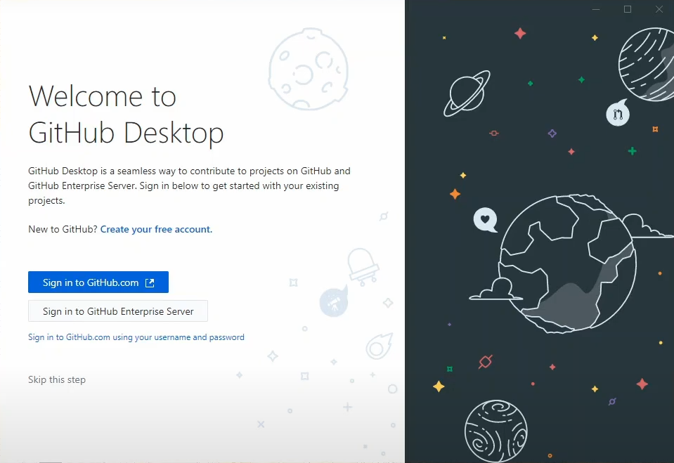
GitHub Desktop Login (Step 1)
Sign in to GitHub.com

Slide 18
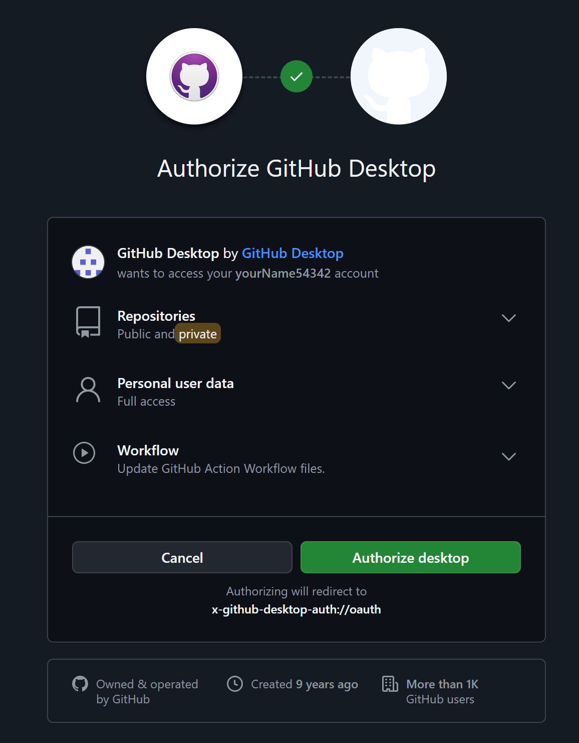
GitHub Desktop Login (Step 2)
Authorize desktop

Slide 19
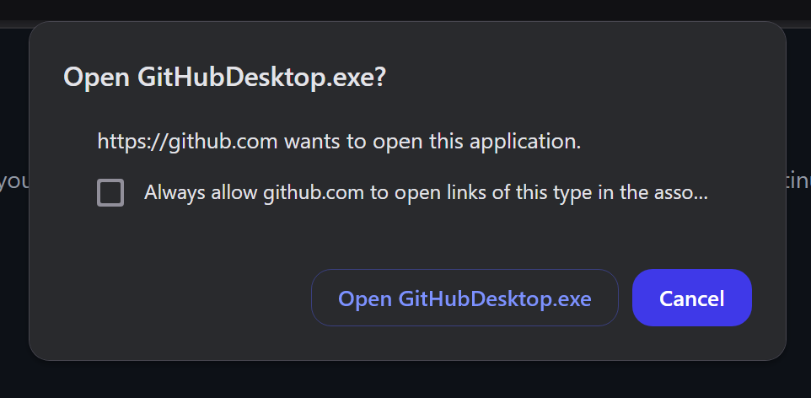
GitHub Desktop Login (Step 3)
Open GitHubDesktop.exe

Slide 20
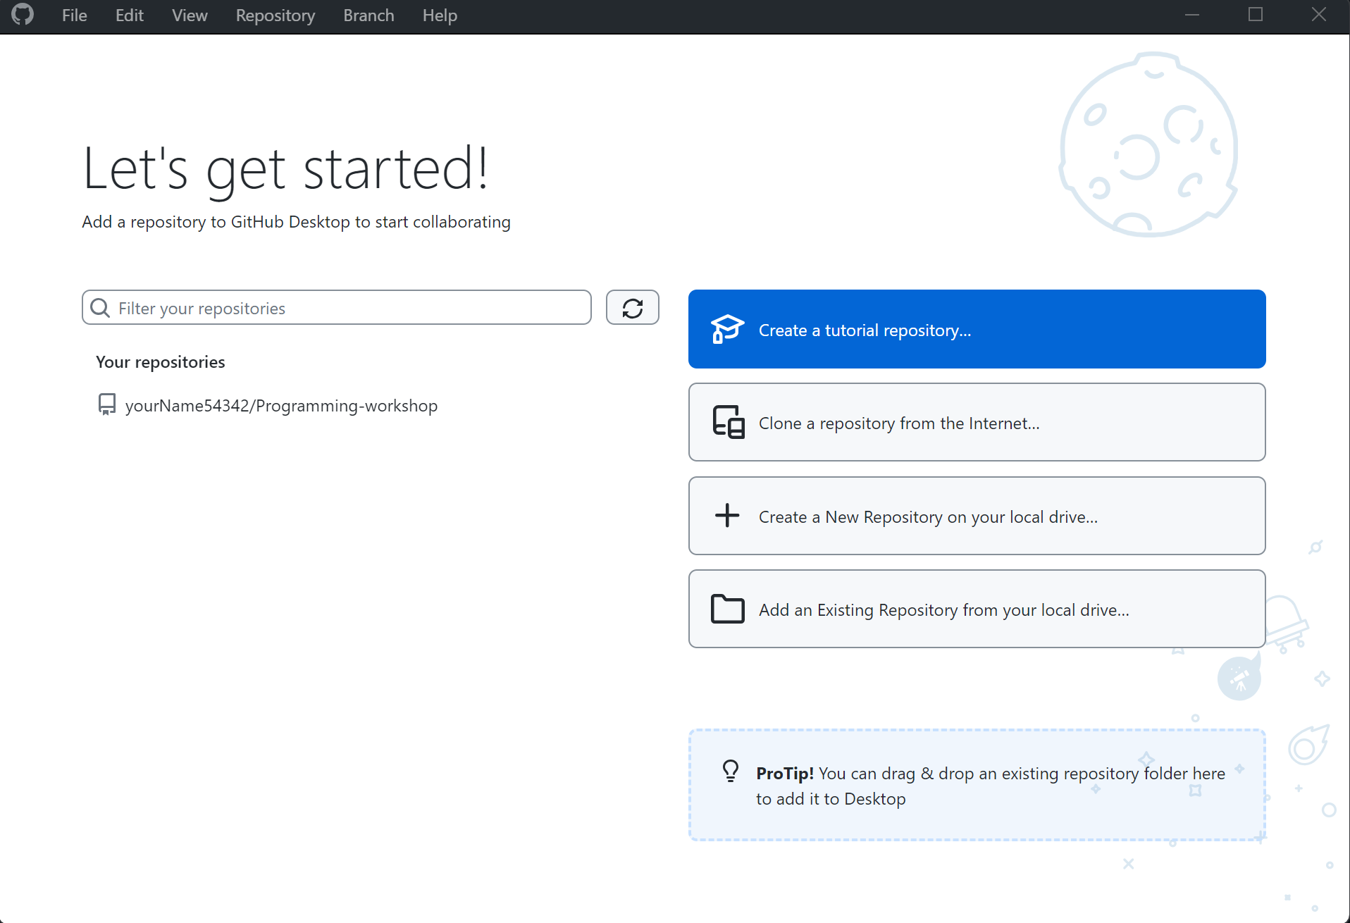
GitHub Desktop

Slide 21
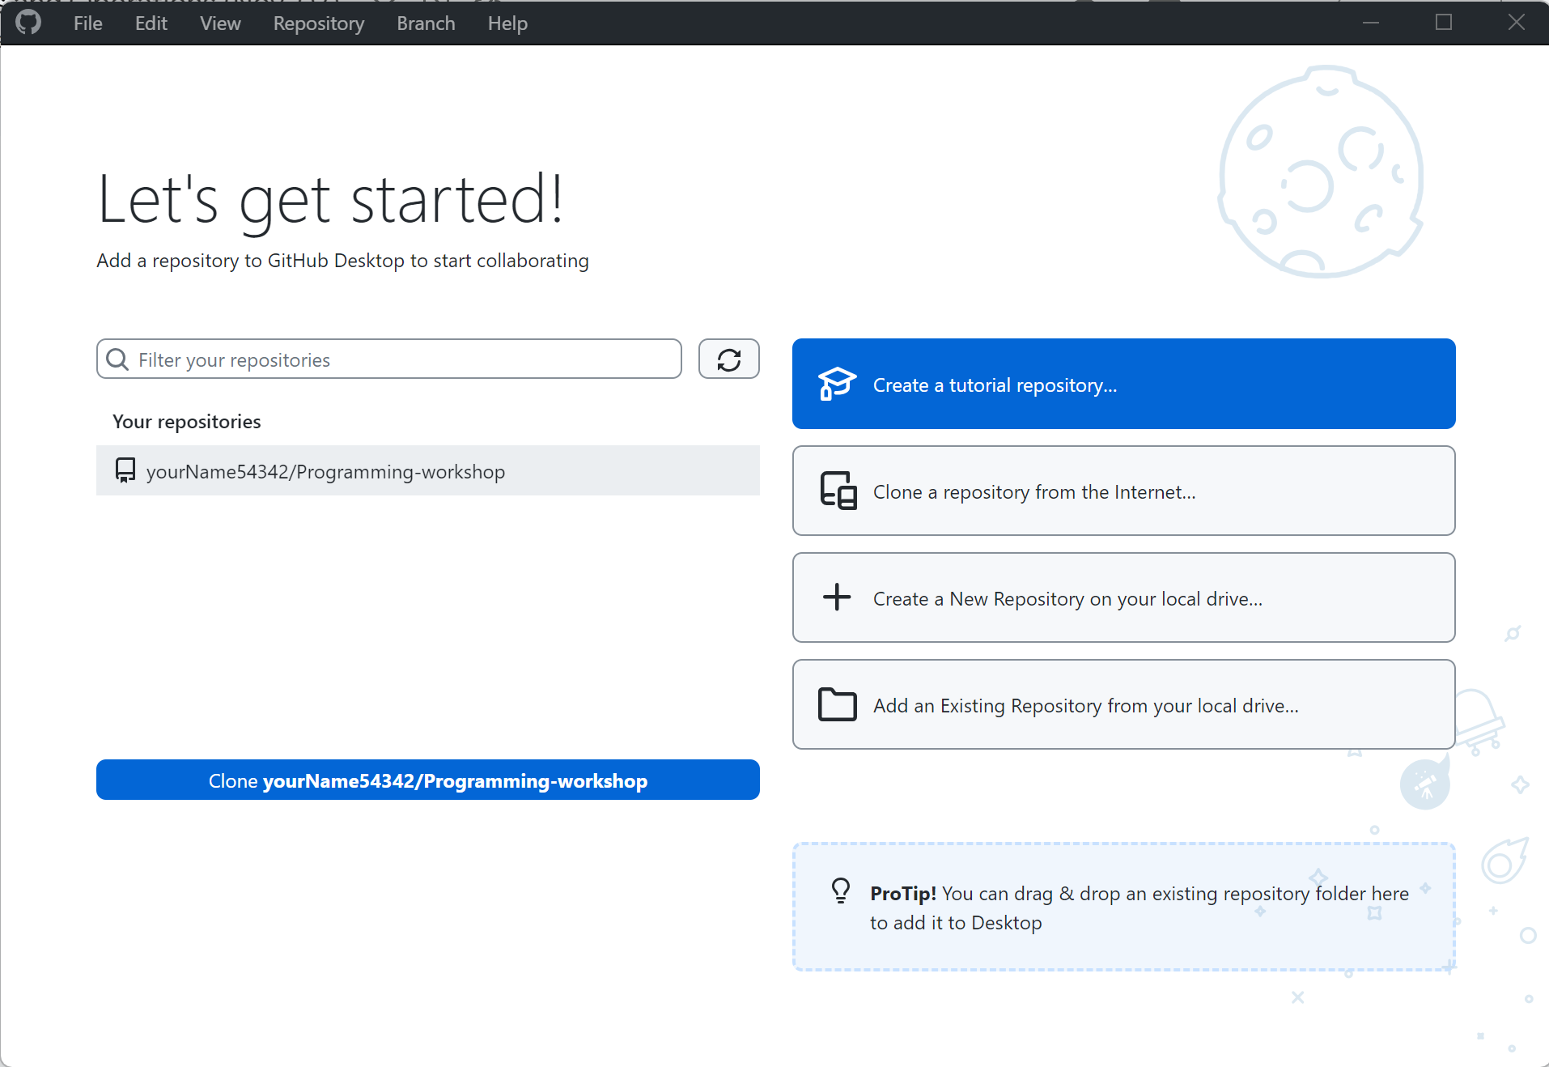
Clone a repository (Step 1)
Clone

Slide 22
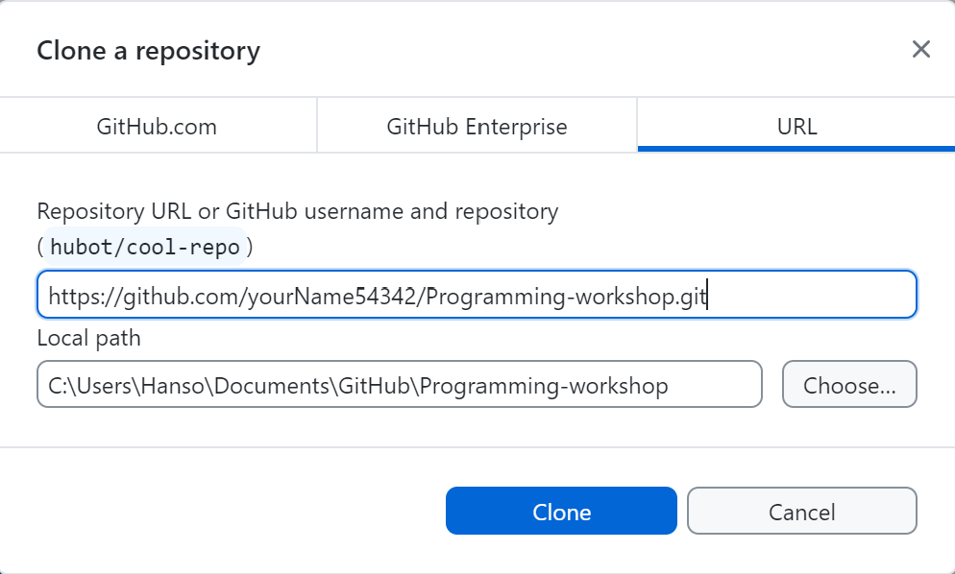
Clone a repository (Step 2)
Clone

Slide 23
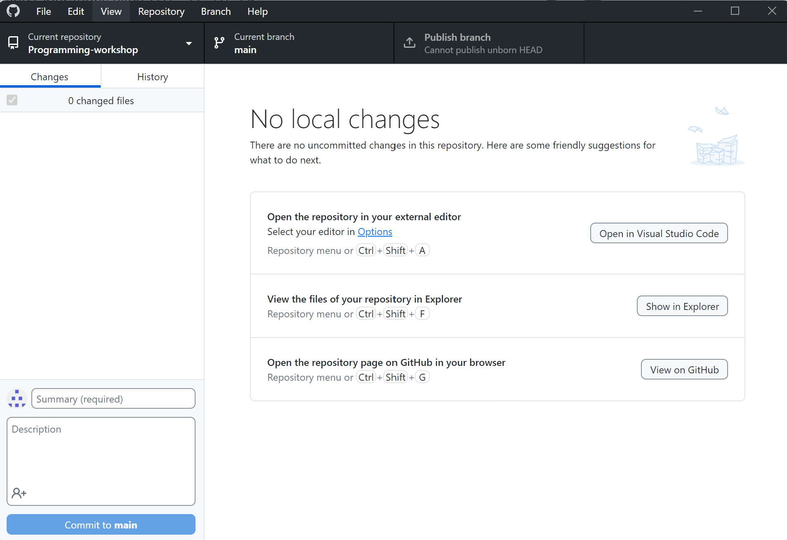
Cloned Repository

Slide 24
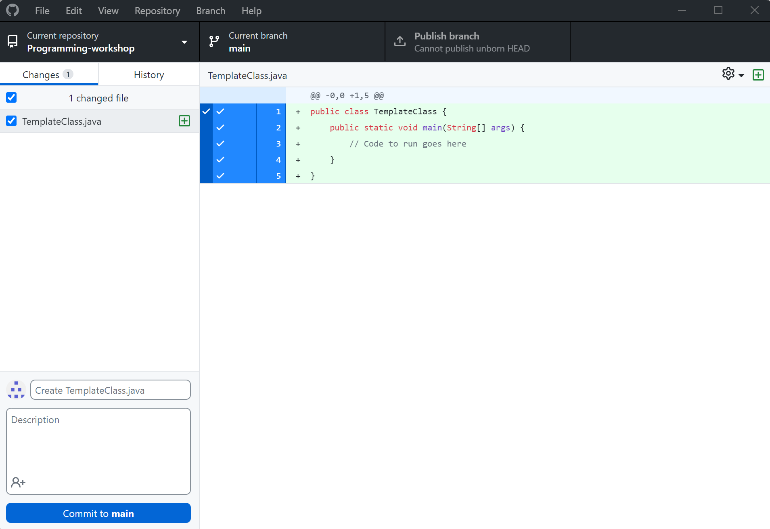
Changes

Slide 25

Commit
Commit

Slide 26
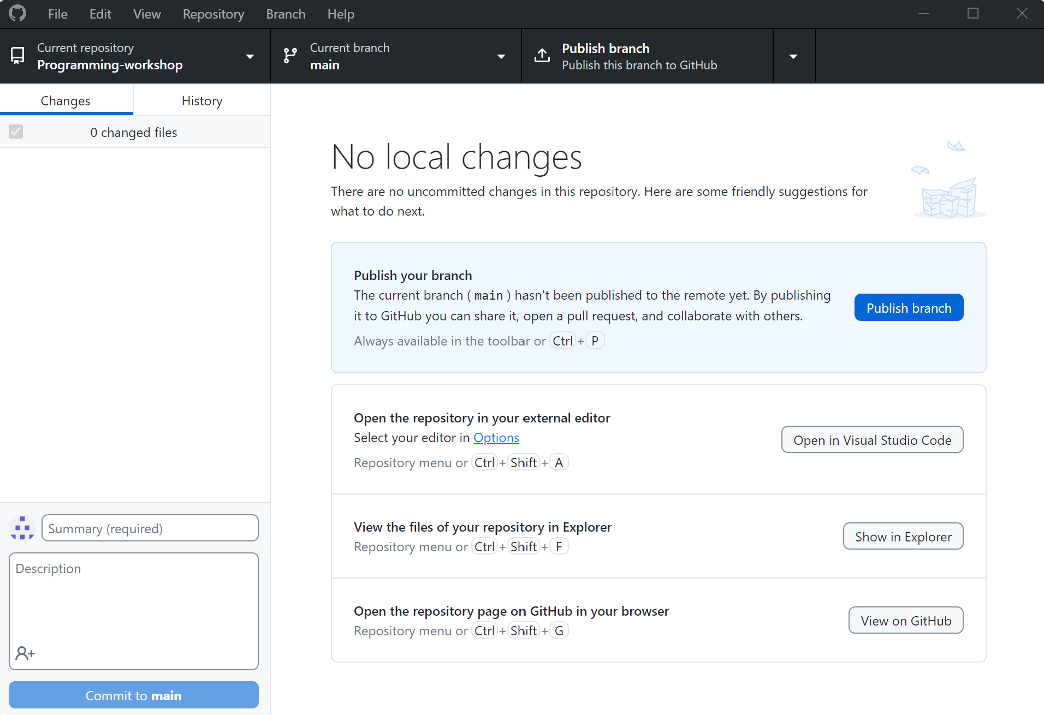
Publish branch
Publish branch

Slide 27
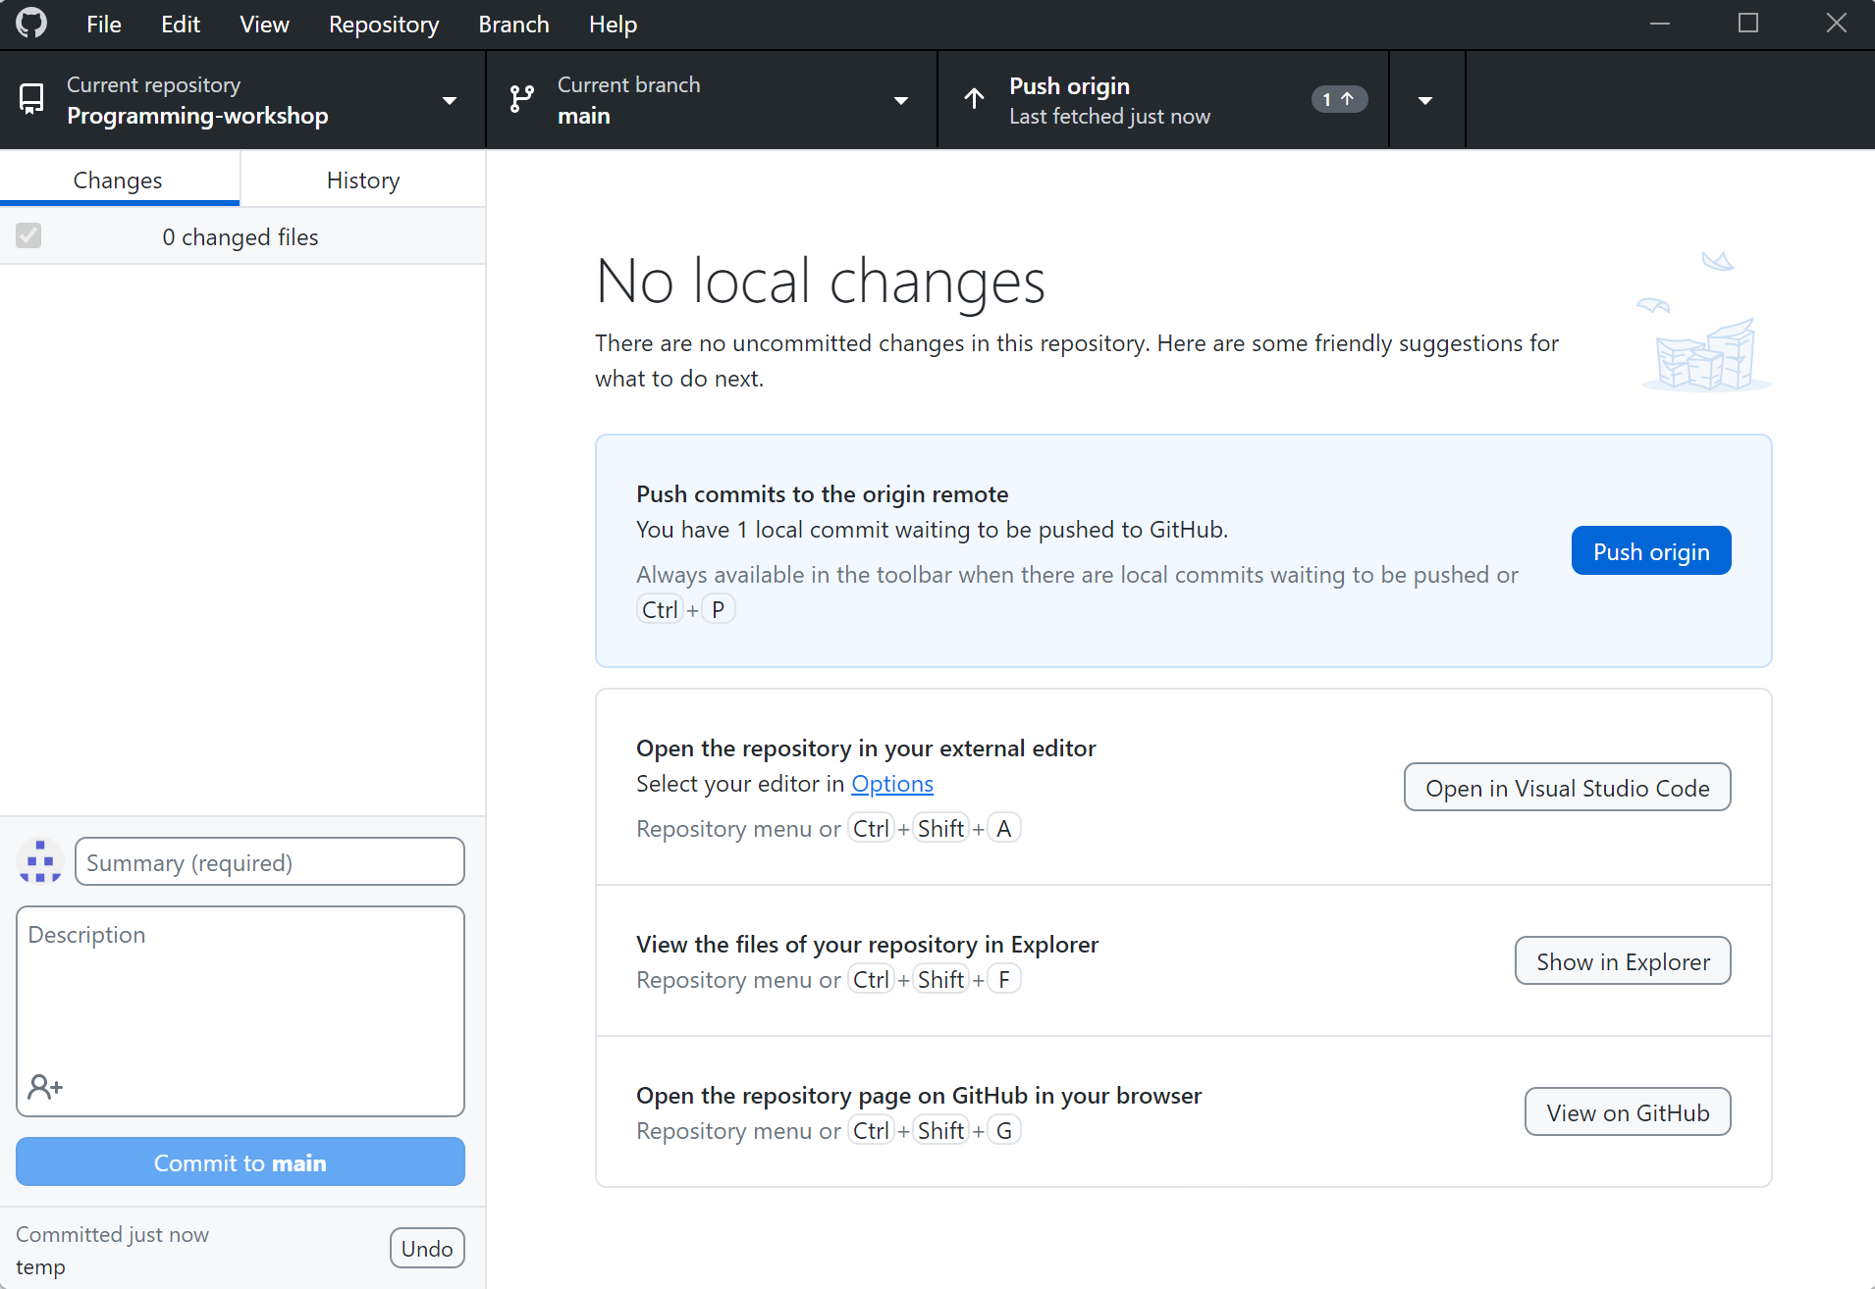
Pushing to GitHub
Push

Slide 28
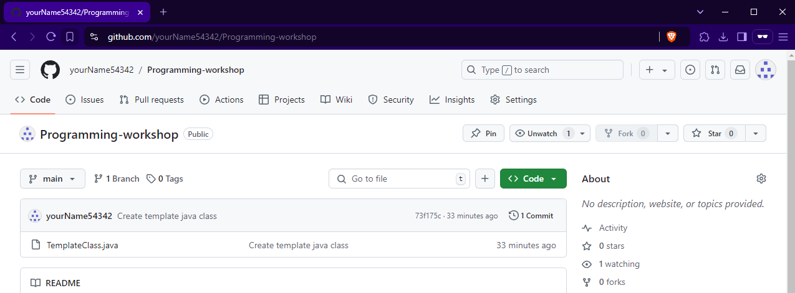
Changes pushed

Slide 29
Cloning in the future (Step 1)
Open Dropdown Menu

Slide 30
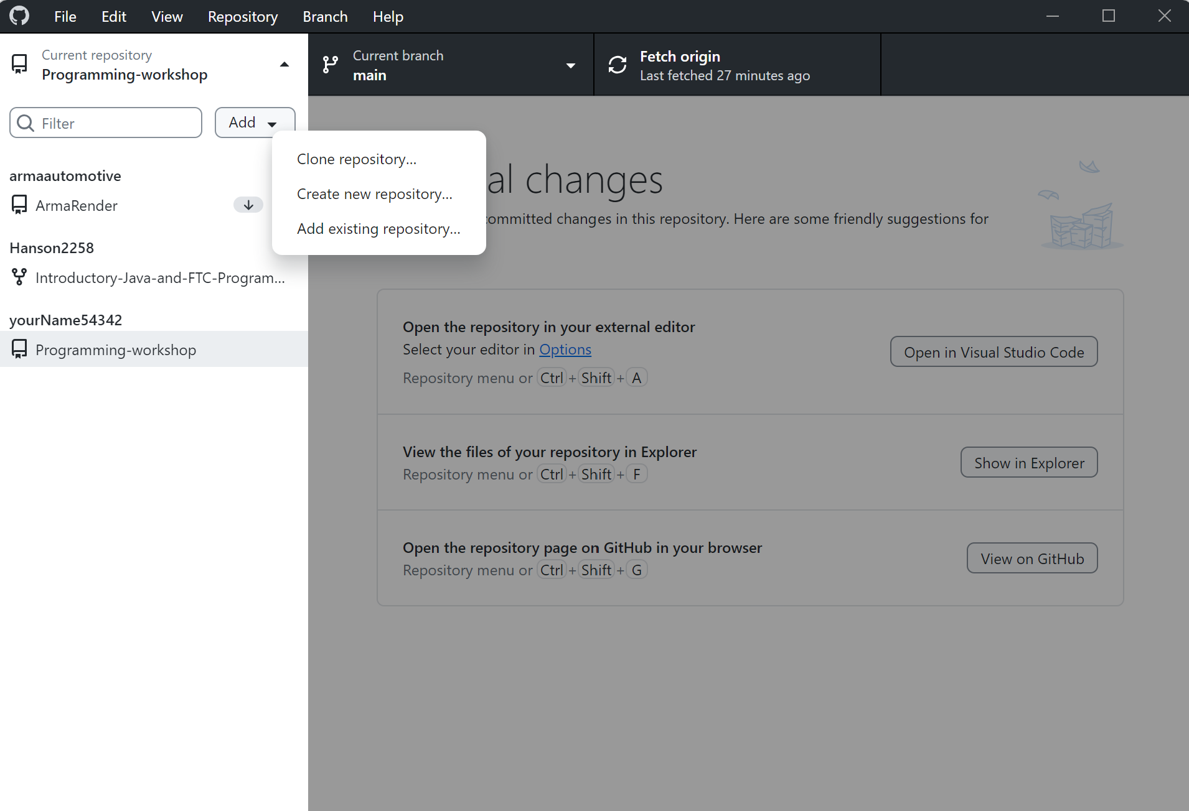
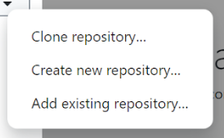
Cloning in the future (Step 2)
Clone repository

Slide 31
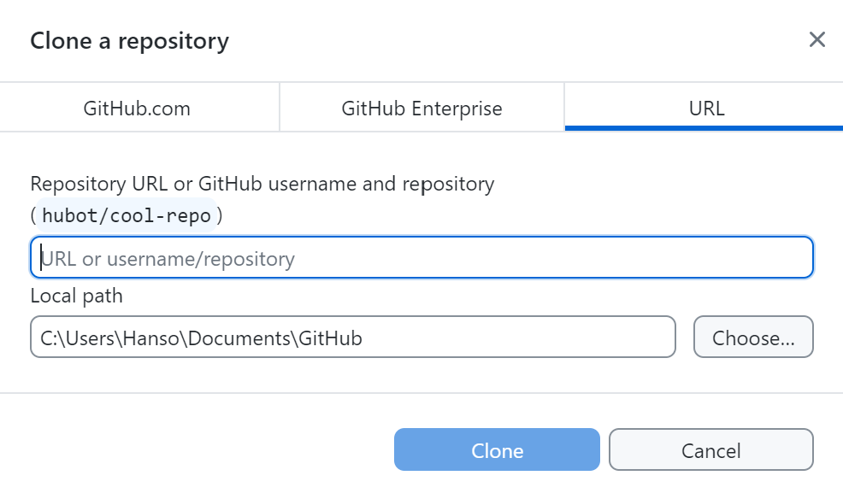
Cloning in the future (Step 3)
Add link of repository
Clone

